Slide 1
System Programming
System Software:
An Introduction to Systems Programming
Leland L. Beck
3rd Edition
Addison-Wesley, 1997

Slide 2
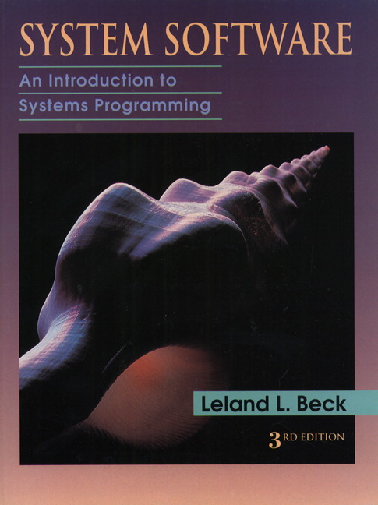
Book
傳說
本書有中文版

Slide 3
Course Information
Time
  7:10pm to 10:00pm on Monday.
Web Sites
  http://140.128.101.171/~johnaxer
Teacher’s email address
  johnaxer@mail.thu.edu.tw
Teaching assistant
  高效能計算實驗室
  http://www.hpc.csie.thu.edu.tw
  陳翠婷

Slide 4
Gain Score
Participation: 5 %
Two quizzes: 20%
Two or Three home works: 15 %
A final project: 15%
A mid exam: 20%
A final exam: 25%

Slide 5
System Programming
Chapter 1: Background
Chapter 2: Assemblers
Chapter 3: Loaders and Linkers
Chapter 4: Macro Processors
Chapter 5: Compilers
Operating Systems
Other System Software
Software Engineering Issues

Slide 6
Chapter 1
Background

Slide 7
Outline
Introduction
System Software and Machine Architecture
The Simplified Instructional Computer (SIC)
  SIC Machine Architecture
  SIC/XE Machine Architecture
  SIC Programming Examples
Traditional (CISC) Machines
RISC Machines

Slide 8
1.1 Introduction
何謂系統程式？
  System Software consists of a variety of programs that support the operation of a computer.
  The programs implemented in either software and (or) firmware that makes the computer hardware usable.
  The software makes it possible for the users to focus on an application or other problem to be solved, without needing to know the details of how the machine works internally.
系統程式就是驅動電腦硬體工作之軟體及韌體程式。
  BIOS (Basic Input Output System)

Slide 9
1.2 System Software and Machine Architecture
System Software vs Application
  One characteristic in which most system software differs from application software is machine dependency.
  System programs are intended to support the operation and use of the computer itself, rather than any particular application.
Examples of system software
  Text editor, assembler, compiler, loader or linker, debugger, macro processors, operating system, database management systems, software engineering tools, …

Slide 10
1.2 System Software and Machine Architecture
Text editor
  To create and modify the program
Compiler and assembler
  You translated these programs into machine language
Loader or linker
  The resulting machine program was loaded into memory and prepared for execution
Debugger
  To help detect errors in the program

Slide 11
System Software Concept
Users
Application Program
Debugger
Macro Processor
Text Editor
Utility Program (Library)
Complier
Assembler
Load and Linker
OS
Memory Management
Process Management
Device Management
Information Management
Bare Machine (Computer)

Slide 12
System Software and Machine Architecture
Machine dependent (與機器相關)
  Instruction Set, Instruction Format, Addressing Mode, Assembly language …
Machine independent (與機器無關)
  General design logic/strategy, Two passes assembler…
Machine independent
Machine Dependent
Computer

Slide 13
1.3 The Simplified Instructional Computer
Like many other products, SIC comes in two versions
  The standard model
  An XE version
    “extra equipments”, “extra expensive”
The two versions has been designed to be upward compatible
SIC (Simplified Instructional Computer)
SIC/XE (Extra Equipment)

Slide 14
1.3 The Simplified Instructional Computer
SIC
  Upward compatible
  Memory consists of 8-bit bytes, 3 consecutive bytes form a word (24 bits)
  There are a total of 32768 bytes (32 KB) in the computer memory.
  5 registers, 24 bits in length
    A 0 Accumulator
    X 1 Index register
    L 2 Linkage register (JSUB)
    PC 8 Program counter
    SW 9 Status word (Condition Code)

Slide 15
1.3.1 SIC Machine Architecture
Data Formats
  Integers are stored as 24-bit binary number
  2’s complement representation for negative values
  Characters are stored using 8-bit ASCII codes
  No floating-point hardware on the standard version of SIC

Slide 16
Instruction Cycle
CPU
  Control Unit (CU)
  Arithmetic and Logic Unit (ALU)
  Register
Instruction Cycle
  Fetch Cycle
  Execution Cycle
Fetch Instruction
Computation
Store Result
Decoder
Fetch Operand

Slide 17
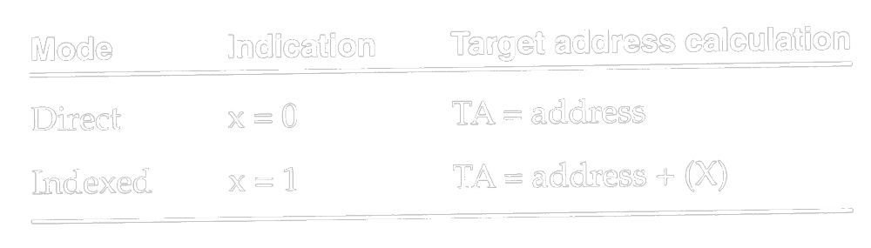
1.3.1 SIC Machine Architecture
Instruction format
  24-bit format
  The flag bit x is used to indicate indexed-addressing mode
Addressing Modes
  There are two addressing modes available
    Indicated by x bit in the instruction
    (X) represents the contents of reg. X
8
1
15
opcode
x
address

Slide 18
1.3.1 SIC Machine Architecture
Instruction set
  Format 3
  Load and store registers (LDA, LDX, STA, STX, etc.)
  Integer arithmetic operations (ADD, SUB, MUL, DIV)
  Compare instruction (COMP)
  Conditional jump instructions (JLT, JEQ, JGT)
  JSUB jumps to the subroutine, placing the return address in register L.
  RSUB returns by jumping to the address contained in register L.

Slide 19
1.3.1 SIC Machine Architecture
I/O
  I/O are performed by transferring 1 byte at a time to or from the rightmost 8 bits of register A.
  Each device is assigned a unique 8-bit code as an operand.
  Test Device (TD): tests whether the addressed device is ready to send or receive
    < ready = not ready
  Read Data (RD)
  Write Data (WD)

Slide 20
1.3.2 SIC/XE Machine Architecture
1 megabytes (1024 KB) in memory
3 additional registers, 24 bits in length
  B 3 Base register; used for addressing
  S 4 General working register
  T 5 General working register
1 additional register, 48 bits in length
  F 6 Floating-point accumulator (48 bits)

Slide 21
1.3.2 SIC/XE Machine Architecture
Data format
  24-bit binary number for integer, 2’s complement for negative values
  48-bit floating-point data type
  The exponent is between 0 and 2047
  f*2^{(e-1024)}
  0: set all bits to 0
1
11
36
S
exponent
fraction

Slide 22
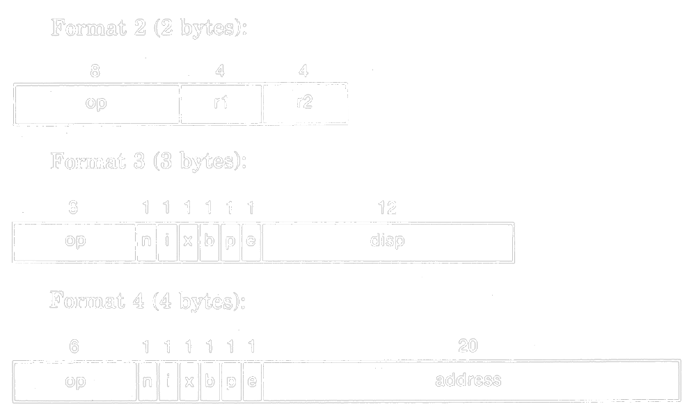
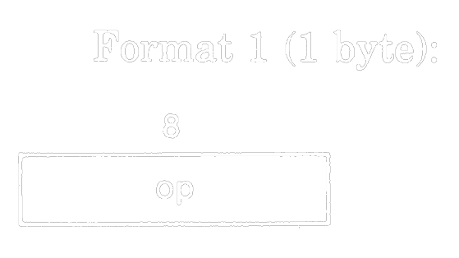
1.3.2 SIC/XE Machine Architecture
Instruction formats
  Relative addressing (相對位址) - format 3 (e=0)
  Extend the address to 20 bits - format 4 (e=1)
  Don’t refer memory at all - formats 1 and 2

Slide 23
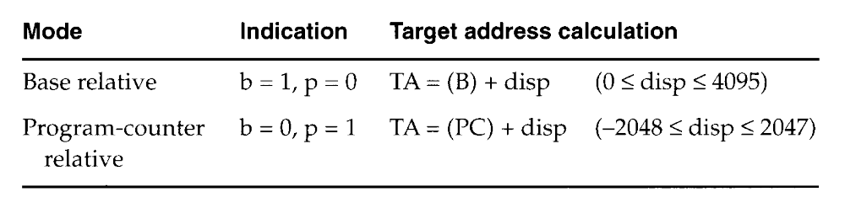
1.3.2 SIC/XE Machine Architecture
Addressing modes
  n i x b p e
  Simple n=0, i=0 (SIC) or n=1, i=1
  Immediate n=0, i=1 TA=Valus
  Indirect n=1, i=0 TA=(Operand)
  Base relative b=1, p=0 TA=(B)+disp
  0 <= disp <= 4095
  PC relative b=0, p=1 TA=(PC)+disp
  -2048 <= disp <= 2047

Slide 24
1.3.2 SIC/XE Machine Architecture
Addressing mode
  Direct b=0, p=0 TA=disp
  Index x=1 TA_{new}=TA_{old}+(X)
  Index+Base relative x=1, b=1, p=0 TA=(B)+disp+(X)
  Index+PC relative x=1, b=0, p=1
  TA=(PC)+disp+(X)
  Index+Direct x=1, b=0, p=0
  Format 4 e=1
Appendix and Fig. 1.1 Example

Slide 25
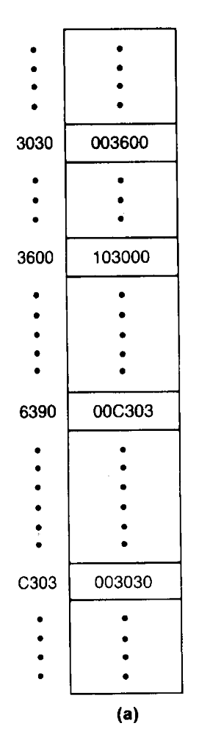
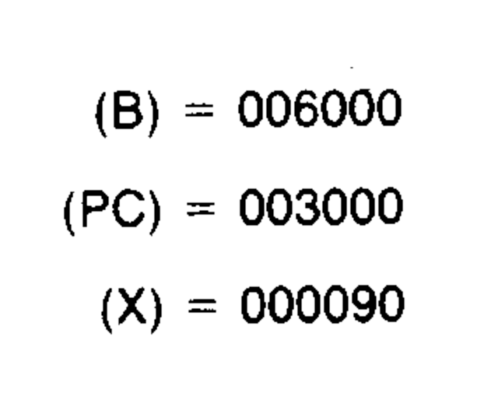
Figure 1.1
Memory address
  00000
  (0000 0000 0000 0000 0000)
  ~FFFFF (Byte)
  (1111 1111 1111 1111 1111)

Slide 26
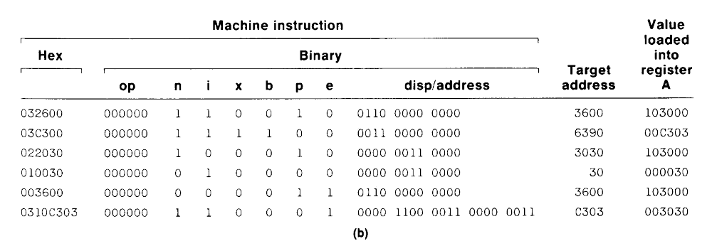

Slide 27
1.3.2 SIC/XE Machine Architecture
Instruction set
  Format 1, 2, 3, or 4
  Load and store registers (LDB, STB, etc.)
  Floating-point arithmetic operations (ADDF, SUBF, MULF, DIVF)
  Register-to-register arithmetic operations (ADDR, SUBR, MULR, DIVR)
  A special supervisor call instruction (SVC) is provided
I/O
  1 byte at a time, TD, RD, and WD
  SIO, TIO, and HIO are used to start, test, and halt the operation of I/O channels.

Slide 28
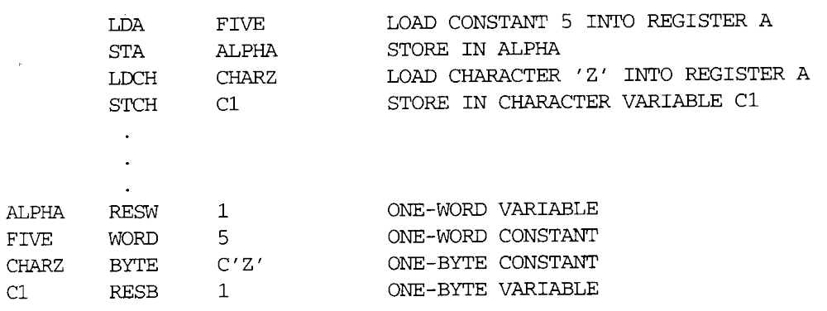
1.3.3 SIC Programming Examples
Sample data movement operations
  No memory-to-memory move instructions (Fig. 1.2)
    LDA five LDA #5
    … …
    five word 5

Slide 29
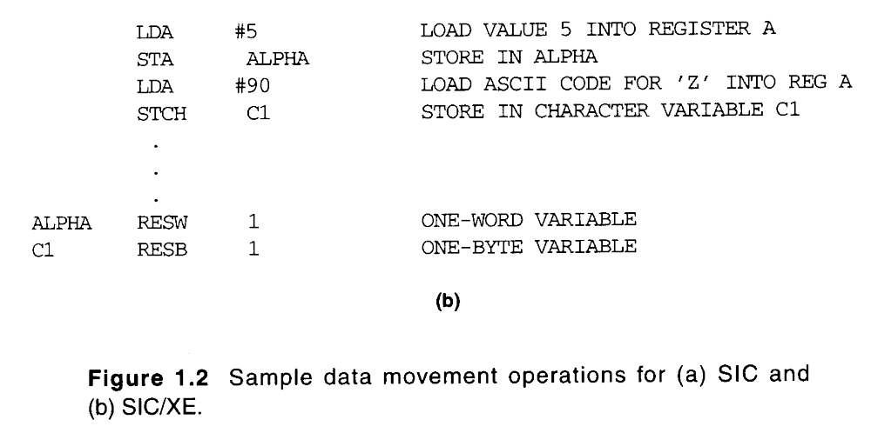
1.3.3 SIC Programming Examples

Slide 30
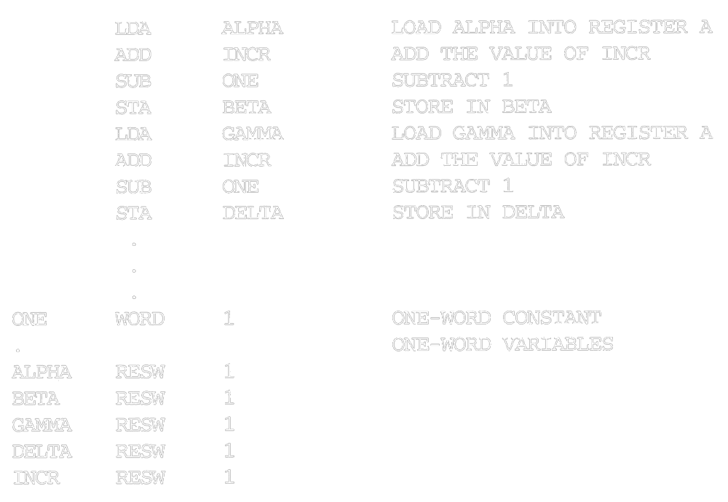
1.3.3 SIC Programming Examples
Sample arithmetic operations
  (ALPHA+INCR-1) assign to BETA (Fig. 1.3)
  (GAMMA+INCR-1) assign to DELTA

Slide 31
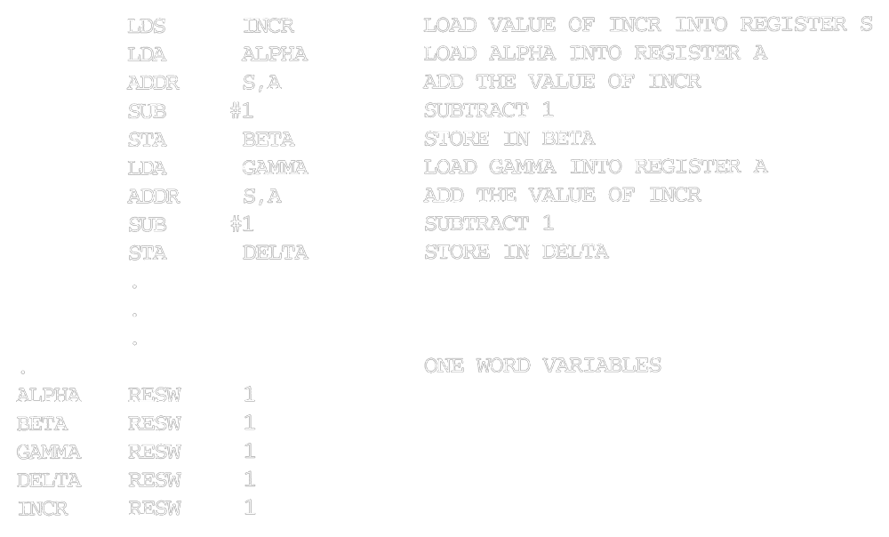
1.3.3 SIC Programming Examples

Slide 32
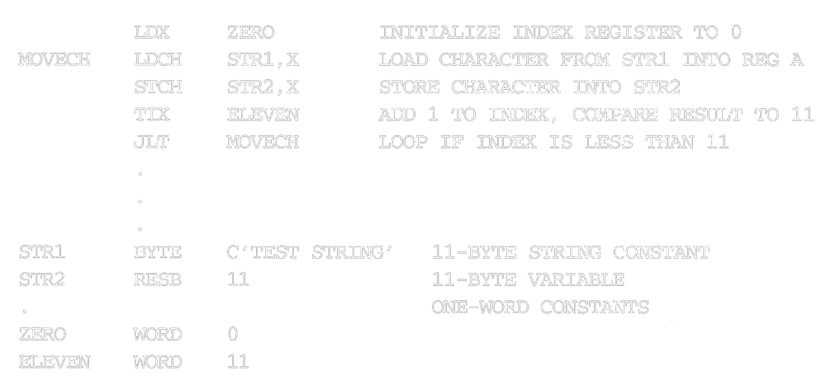
1.3.3 SIC Programming Examples
String copy

Slide 33
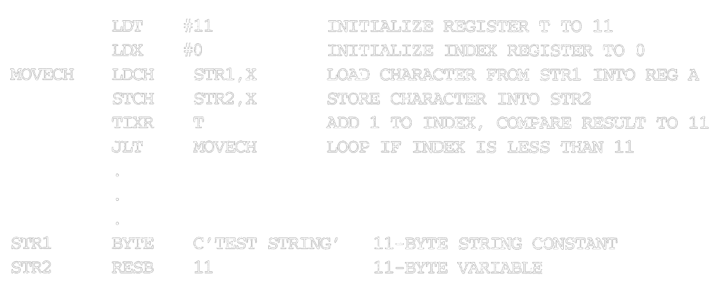
1.3.3 SIC Programming Examples

Slide 34
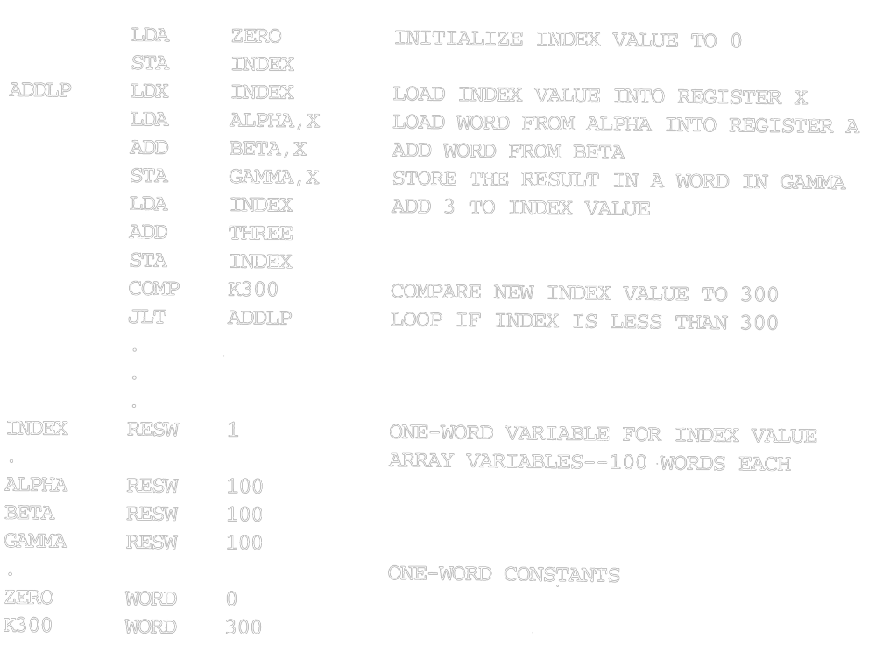
1.3.3 SIC Programming Examples

Slide 35
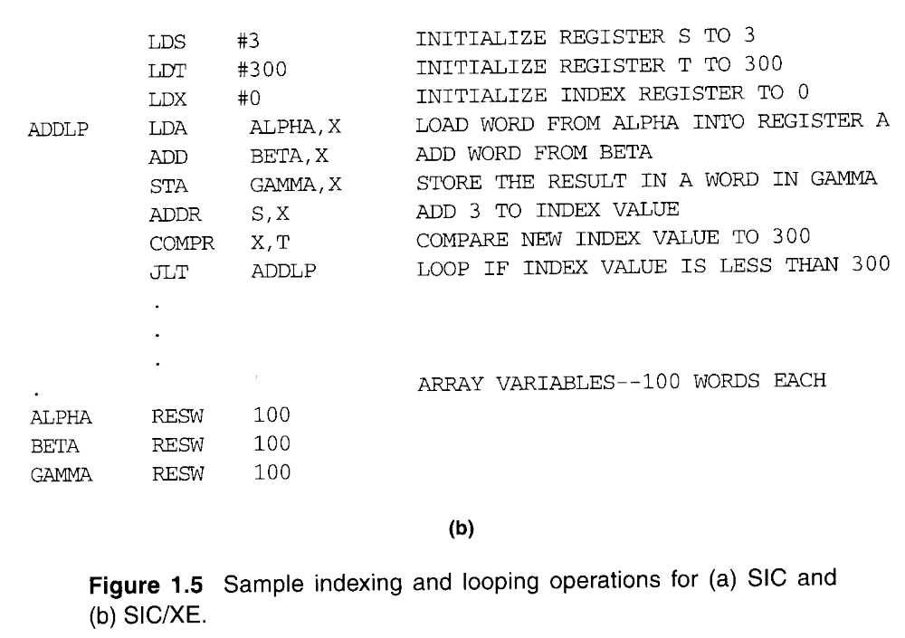
1.3.3 SIC Programming Examples

Slide 36
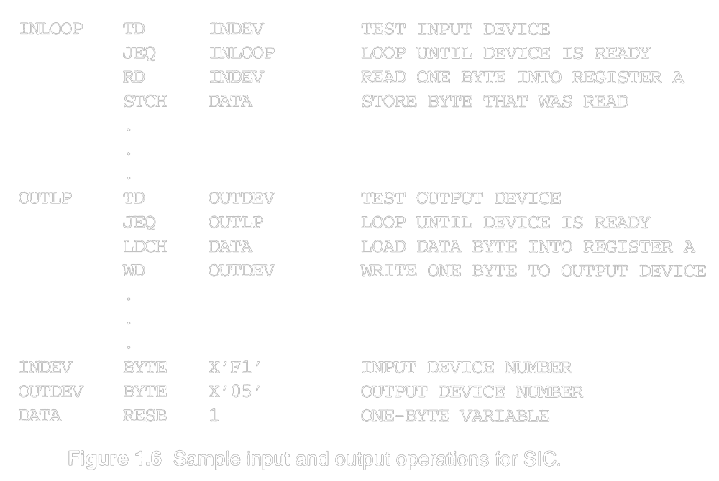
1.3.3 SIC Programming Examples

Slide 37
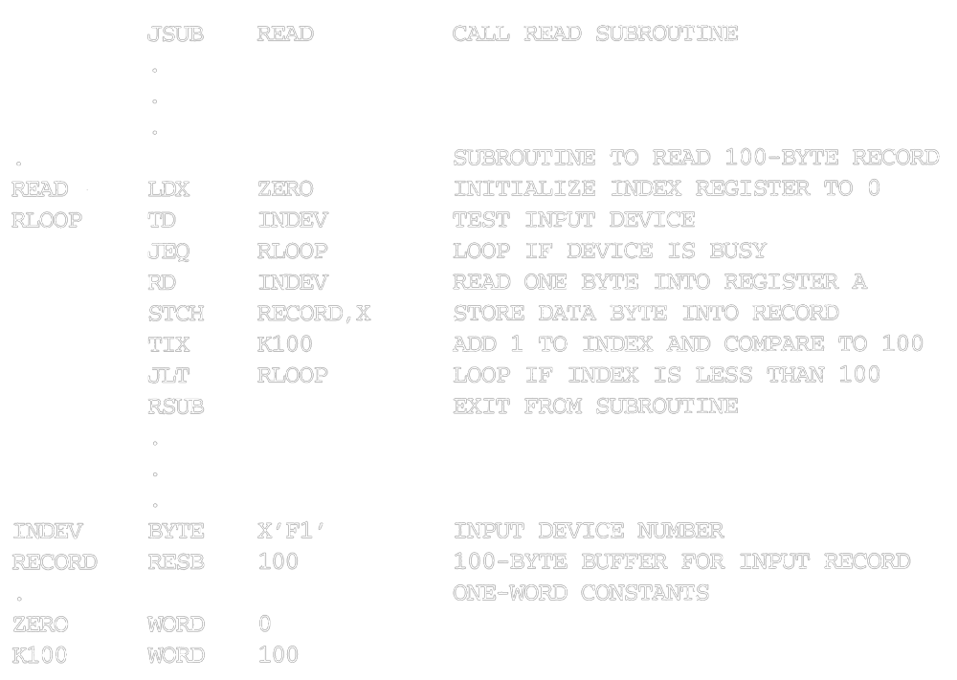
1.3.3 SIC Programming Examples

Slide 38
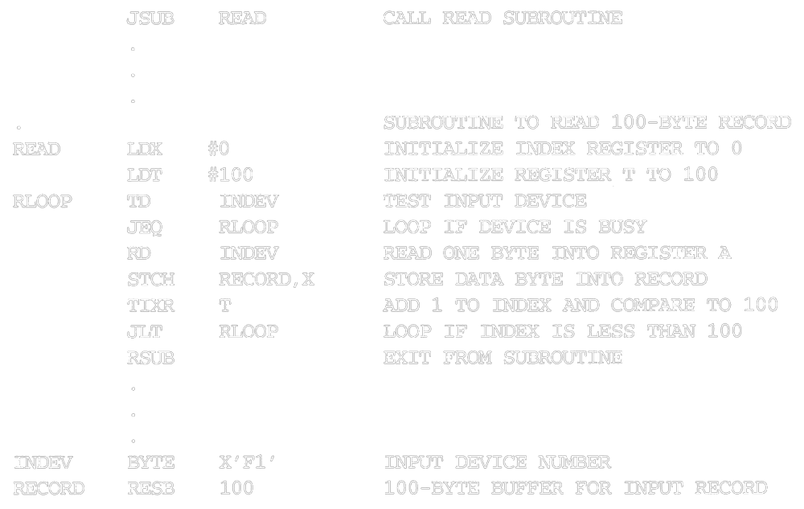
1.3.3 SIC Programming Examples

Slide 39
Traditional (CISC) Machines
Complex Instruction Set Computers (CISC)
  complicated instruction set
  different instruction formats and lengths
  many different addressing modes
  e.g. VAX or PDP-11 from DEC
  e.g. Intel x86 family
Reduced Instruction Set Computer (RISC)

Slide 40
RISC Machines
RISC system
  instruction
    standard, fixed instruction format
    single-cycle execution of most instructions
    memory access is available only for load and store instruction
    other instructions are register-to-register operations
    a small number of machine instructions, and instruction format
  a large number of general-purpose registers
  a small number of addressing modes
  Three RISC machines
    SPARC family
    PowerPC family
    Cray T3E

